Slide 1

Tiny ML & Machine Learning
COCSC19
Submitted by: Gourav Singal
Submitted to: Mrs. Poonam Rani
Roll No. 2019UCO1571

Slide 2

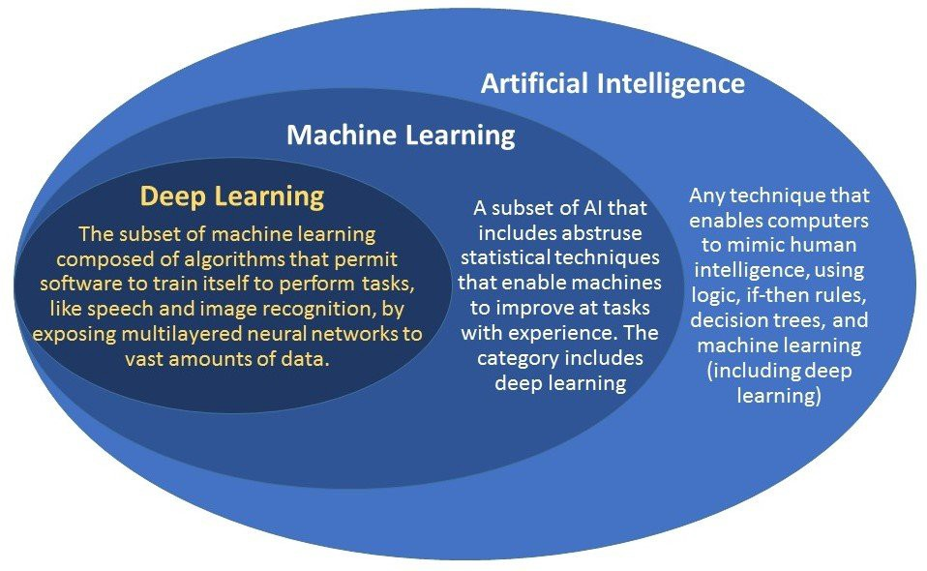
What is Machine Learning?

Slide 3
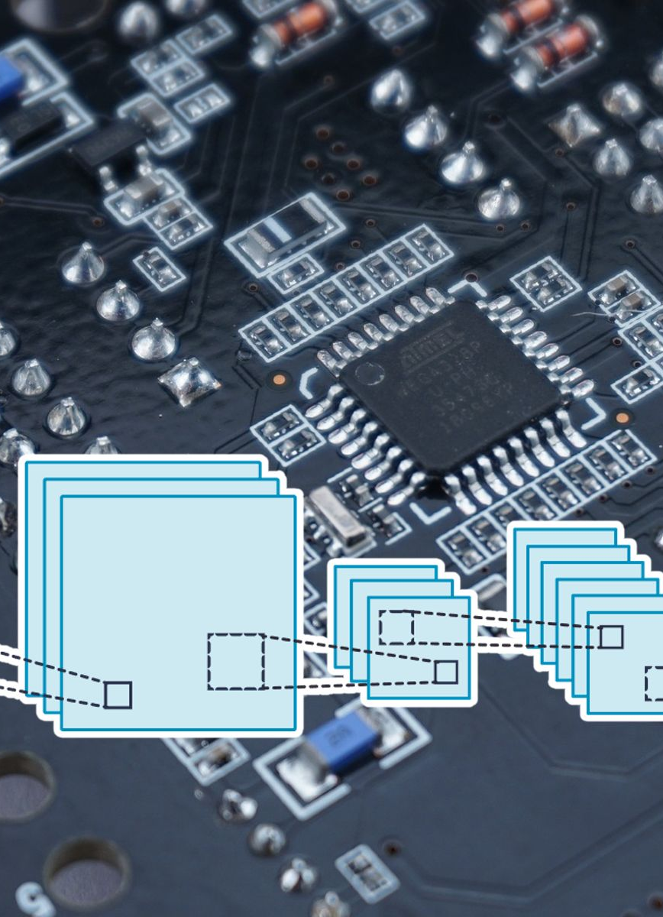
What is Tiny ML?
Tiny machine learning (Tiny ML) is the intersection of machine learning and embedded internet of things (IoT) devices. The field is an emerging engineering discipline that has the potential to revolutionize many industries.
Tiny ML is a framework that allows neural network to run on edge devices (low power devices with limited ram and CPU power). This is a very complex challenge as most neural networks run on a GPU or an AISC which are very powerful and energy hungry.
the Tiny ML system is flashed with binary files which are generated from the trained model on a larger host machine
Tiny ML emerged from the concept of the internet of things (IoT). The traditional idea of IoT was that data would be sent from a local device to the cloud for processing.

Slide 4




Difference between ML and Tiny ML

Slide 5
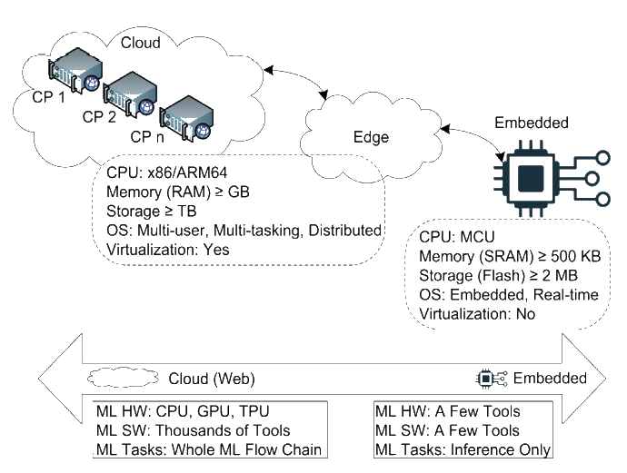
On the basis of components
ML:
Works on powerful CPU, GPU and AISC namely TPU (Tensor Processing Unit).
Even the inbuilt graphic card have more memory than most powerful edge devices and physical memories can even go into hundred of gigabytes.
They requires huge amount of electricity to run
These systems can train and run very powerful, complex and sophisticated neural networks(machine learning algorithms)
They have high speed network access to access cloud resources.

Slide 6
On basis of components
Tiny ML
Very slow processor which can only execute a few thousand basic operations per second
No specialized hardware(GPU/TPU) to accelerate process
Works on as little as a few milliwatts (mW)
A very little ram and storage
Works on a specialized problem, for e.g. a security camera only works intrusion detection and do nothing else with the data, no other operation
Can’t store any previous data because of limited storage

Slide 7
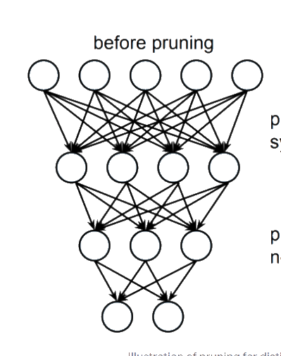
On the basis of layers
ML:
Vary from a simple neuron to a network of tens of hundreds of layers
High degree of representational capacity i.e. a neuron depends on many or all of previous inputs and thus requires large computation
Can extract more information
Can make out more patterns from the data
Slow to compute
Can have a complex neuron weight and bias

Slide 8
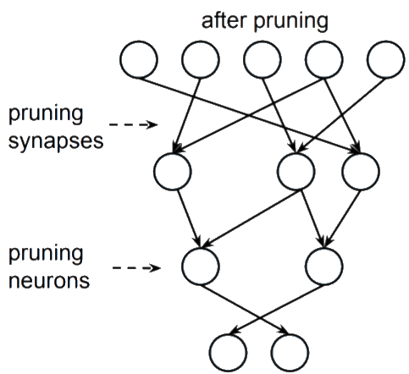
On the basis of layers
Tiny ML
Low representational capacity
At max tens of layers
Made by pruning synapses and pruning neurons
Made from network trained on powerful arch. By
small neural weights
network is then retrained on the pruned architecture to fine-tune the output.
Efficient and fast processing

Slide 9
On the basis of Applications
Machine learning works on servers to work on big problems while Tiny ML can be implemented to solve problems on IOT devices at hand, and can be implemented in smart wearables, embedded in clothes, monitor products in store and countless other things
Tiny ML can only work on basic problems and also can’t be used to train model, It only converts already trained model to a simpler models
Image classification, prediction and other complex tasks can’t be achieved with edge devices
A machine learning algorithm run on modern machines are capable of doing many great things.
For ex. A Nvidia RTX 3090 can process around 1400 images per second for feature extraction/classification while a edge device may take a lot of time for working on a single image. But a 3090 will be using like 460 watts of power which is not an option for a edge device

Slide 10
Applications of machine learning
IMAGE RECOGNITION
PRODUCT RECOGNITION
Sentiment Analysis
Automating Employee Access Control
Regulating Healthcare Efficiency and Medical Services

Slide 11

Applications of Tiny ML
keyword spotting
visual wake words
gesture recognition
IOT hardware
monitor shelves in stores
embedded in livestock wearables to monitor vital parameters
monitor critical as well as palliative care patients in real-time, sending out alerts when emergency action is required.

Slide 12
Thank You

